Slide 1

1. Environment
Host PC : Notebook ASUS ROG Strix G731:
Hardware :
CPU :
Intel® Core ™ i7-9750 CPU 2.6GHz
Cores : 6
Threads : 12
Ram :
Dual with 2 RAM slots (8G-8G)
Type : DDR4-2666
Total Size : 16G
GPU : GTX 1650

Slide 2
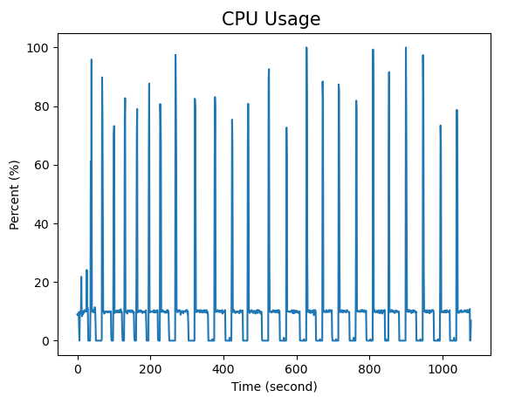
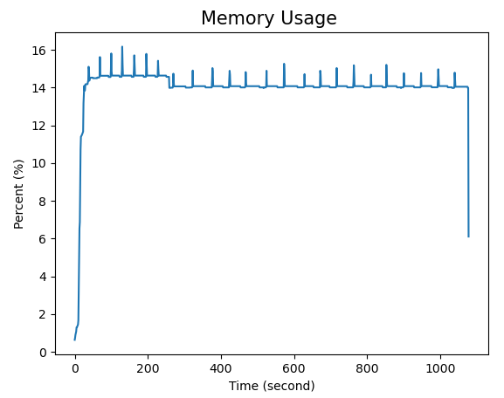
2. Results
Host PC
Time to complete running the application : 17.93 min
Average : 10.44 %
Average : 14.00 %

